Slide 1
A Dragon Has Destroyed the DataCentre
Brian Nisbet
HEAnet
@natural20
Notes:
A Dragon Has Eaten your DataCentre: Roleplaying Your Disaster Scenario
Humans do two things, we tell stories and we play games, RPGs are a combination of that and tapping into it can be so powerful
We all know about roleplaying, it's what any DR/BCP scenario is, of course, and it has been around for a long time, people have been imaginging things, telling stories, getting involved.
So why am I talking about it?

Slide 2
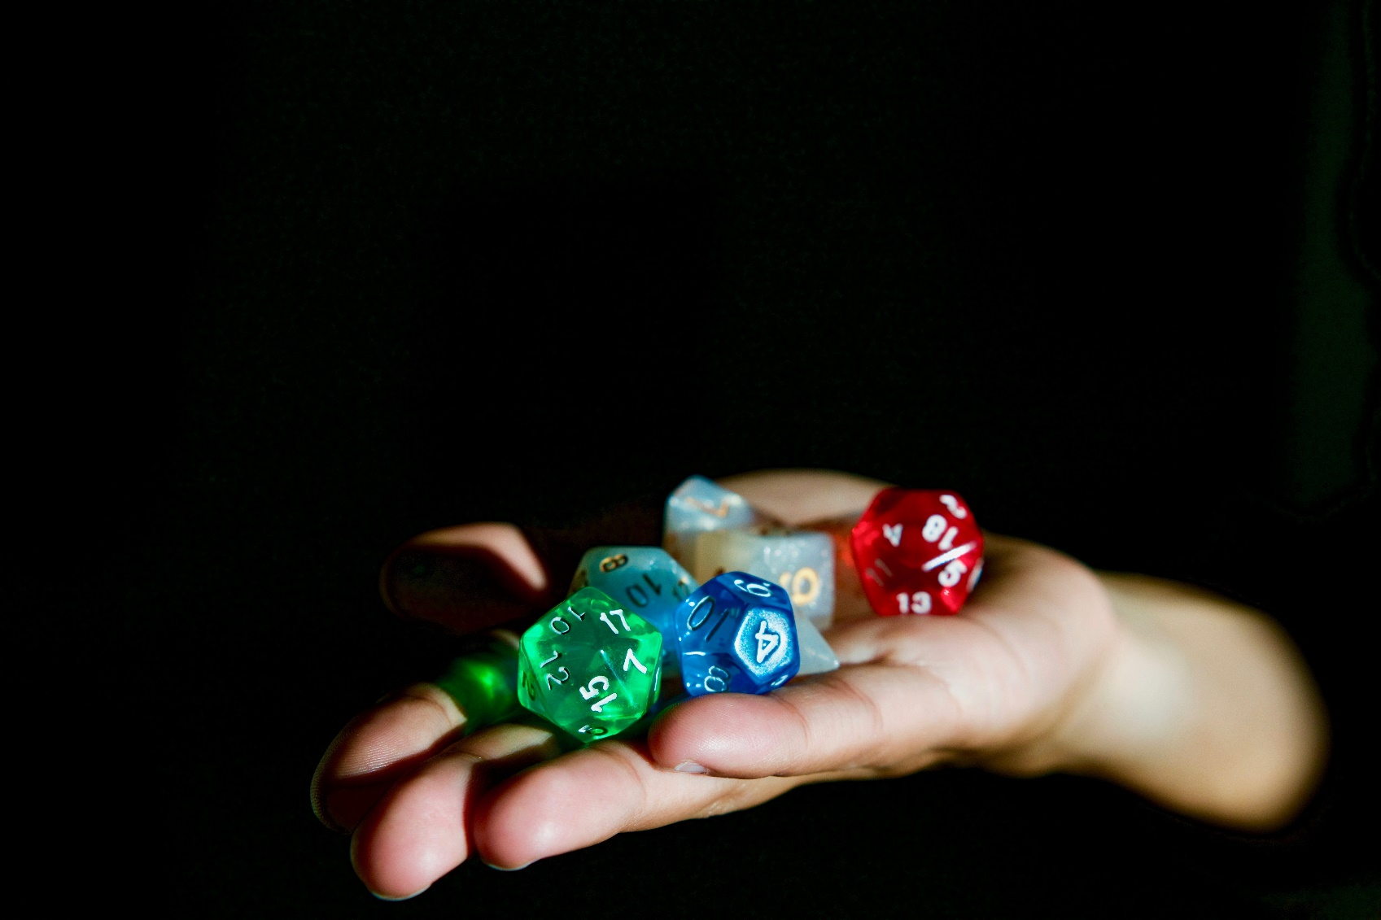
Photo by Alex Chambers on Unsplash
Notes:
- Explosion of codified systems from the 1970s, starting with D&D. Fantasy is the most famous genre, but there are SciFi, Horror, Comedy, Superhero, Real Life etc. etc. games now
- So millions of people playing thes games leads to a lot of thinking about how to keep people engaged, how to avoid too much distraction from snacks, phones, other people and how to keep it fun
I want to focus on the role of the Games Master, or for us, the person running the DR/BCP scenario
Running an RPG can be a major challenge, keeping people interested, keeping the story going, without the benefit of this being something people have to do as part of their job, like they might have to do a DR/BCP scenario in work, but obviously it's better for everyone when people are engaged and are, overall, having fun
GM led systems vs GM-less systems, the same as a shared scenario with pre-set conditions (the office is offline) or something dynamic
Shared narrative control can be interesting too
It has to be, above all, fun
Each system has hints and tricks to do this
I put some of this into effect in HEAnet's 2017 exercise. Some of it is "common sense", doubtless some/all of you have done things like this, but hopefully some of it will be useful.

Slide 3
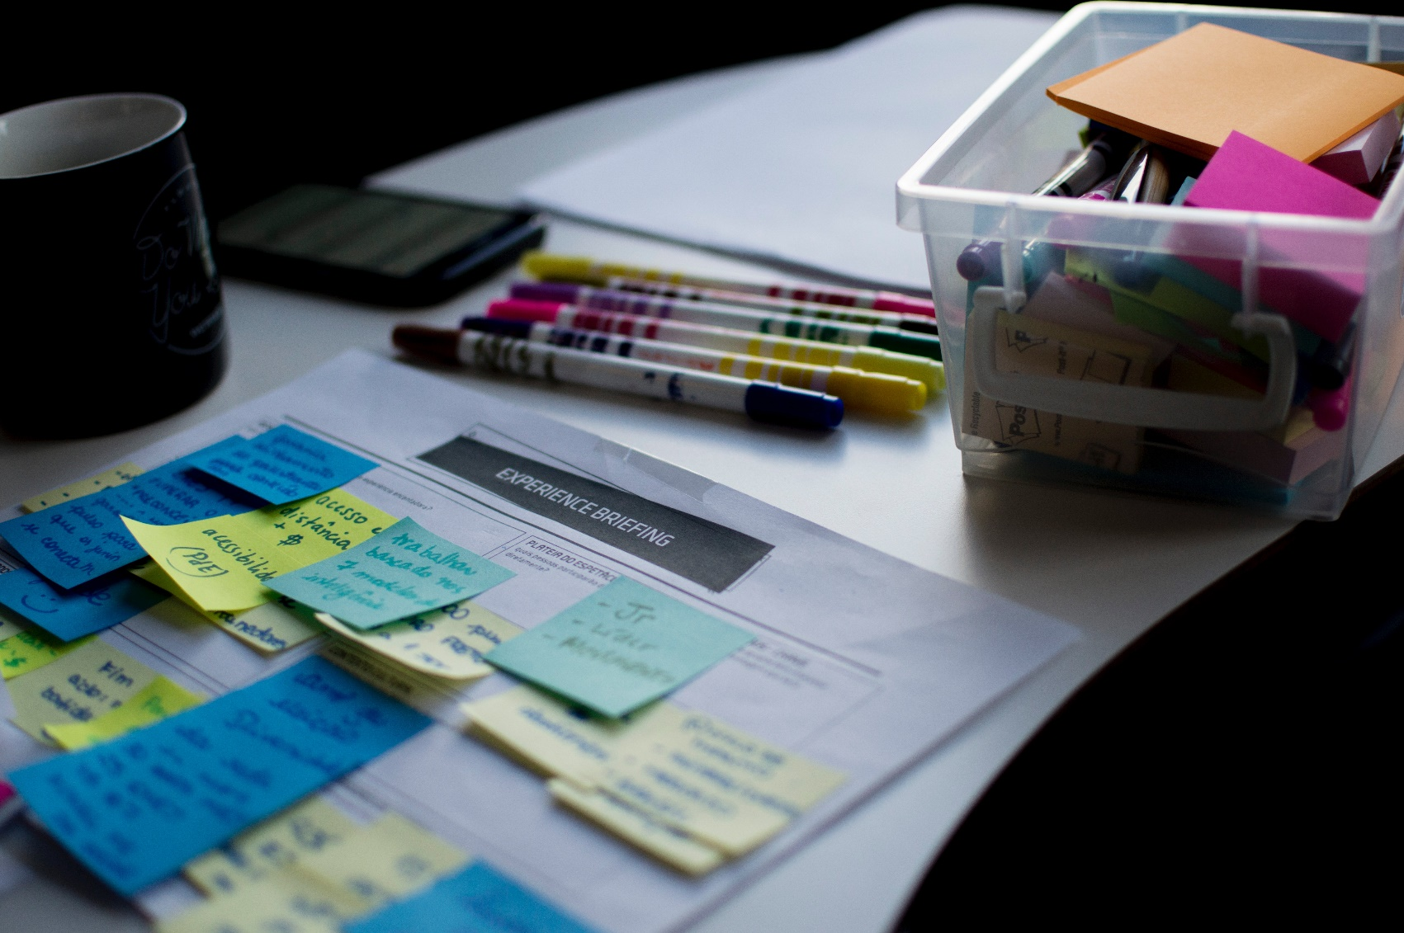
Notes:
- Define the world/situation carefully, but make it plausible, try to have answers for obvious questions, breaking that suspended disbelief will lead to disengagement really quickly
- Colleagues/Players are fundamentally both very intelligent and evil. Your plan will not survive contact with them. They will come up with ways to break things, roll with it.
- There's no magic in this world, nobody can cast a spell or use a super power in ways you don't expect, but they can do other things. Scripts, tools, good process, detailed resilience, sudden blasts of genius, all of these can derail a plan, make disasters smaller, roll with it.

Slide 4
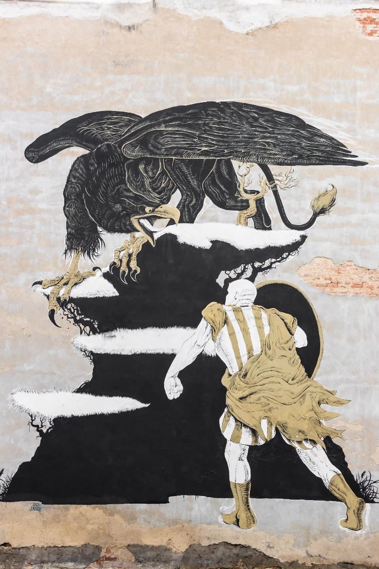
Notes:
- No situation should be insurmountable. Difficult, sure, but you've got to temper the challenge. Nothing is as demotivating as feeling you can't win

Slide 5

Notes:
- But... not everything has to be obvious or clear. Why is the company being attacked? Why did the fire prevention systems fail? Is something going on beyond the obvious. Not suggesting supernatural, but conspiracy theories and investigations add spice
- Give the participants freedom, don't railroad them too much, give them flexibility to to think and experiment, but also to make mistakes, the aim here isn't to be evil, it's to allow people to learn, but setting traps for people makes them think

Slide 6

Notes:
- Make sure there's something for everyone, if people don't feel like they can contribute, they won't engage
- Don't let one person dominate. A big issue in RPGs is one player taking all the time, making decisions, you need to specifically call out those who aren't getting a chance to speak or suggest solutions/plans
- Always keep people guessing, unbalanced, life isn't fair

Slide 7

Notes:
- Moments of quiet, of calm, are good, let people breathe, but they also serve the purpose of potentially letting people think things are done

Slide 8
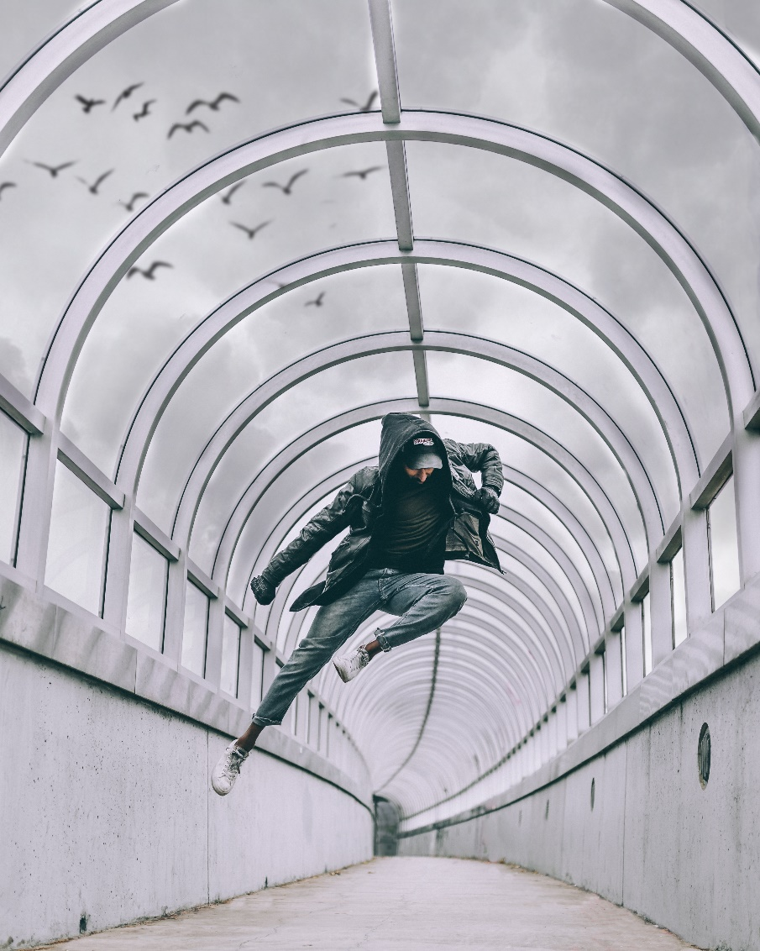
Notes:
- Always remember ninjas (another node going down, a UPS failing)
Always keep people guessing, unbalanced, life isn't fair
Randomness is a big part of RPGs, but is not generally a big part of work scenarios, but the mechanics could be interesting. Does the troubleshooting find the issue? Does the fix hold? The introduction of randomness doesn't have to be obvious, but again, it needs to be realistic

Slide 9

Notes:
- It is just a game, sometimes a time-out might be necessary, a check that everyone is ok. Sure, you want to see how your colleagues react, but staff welfare is incredibly important

Slide 10

Notes:
- Have victory conditions, but don't define them too closely, have a conclusion, wrap up is as important as scene setting, not just the lessons learned, but also explaining to people what was going on. Unless there's a series of linked exercises, you want people to get a sense of closure and revelation. They want to slay the dragon and claim the treasure and, in general, a famous victory with lessons learned is the best long term result for everyone

Slide 11
A Dragon Has Destroyed the DataCentre
Brian Nisbet
HEAnet
@natural20

